Slide 1
Part 1: Introduction

Slide 2
Summary
Contact information
Course objective and topics
Course evaluation
* The layering principle of network protocols
* Connection-oriented and connectionless services
Service primitives
The relationship of services to protocols
* Reference models

Slide 3
(1) Contact Information
Course web page: http://www.csc.uvic.ca/~wkui/Courses/networks/index.htm
Lab web page: http://www.csc.uvic.ca/~csc450
Webboard: http://webboard.uvic.ca/
Instructor: Kui Wu
Email: wkui@cs.uvic.ca
Office hours: TW 2:00 - 3:00 p.m.
EOW: 233

Slide 4
(2.1) Course Objectives
To help you gain a general understanding of the principles and concepts governing the operations of computer networks;
To provide you with the opportunity to become skillful in the implementation and use of communication protocols;
To help you grasp the basic research methodologies in the field of computer networks (for CSc 550 students).

Slide 5
(2.2) Topics
Overview of network layers and protocols
The Physical Layer
- transmission media
- the Nyquist limit and the Shannon limit
* The Data Link Layer
- framing
- error detecting and correcting codes
- sliding window protocols
* The Medium Access Control Layer
- ALOHA
- IEEE 802.3
- IEEE 802.11
* The Network Layer
- routing algorithms
- congestion control
- IP
* The Transport Layer
- connection establishment/termination
- multiplexing
- flow control
- TCP and UDP
Utility Protocols

Slide 6
(3) Course Evaluation
For CSC 550 Students:
Two lab projects: 30%
Midterm exam: 20%
Final exam: 40%
Course project: 10%
For CSC 450 Students:
Two lab projects: 40%
Midterm exam: 20%
Final exam: 40%
Final Grade:
F D C C+ B- B B+ A- A A+
0-49 50-54 55-59 60-64 65-69 70-74 75-79 80-84 85-89 90-105

Slide 7
(4.1) Protocols
Basically, a protocol is an agreement between the communicating peers on how communication is to proceed.

Slide 8
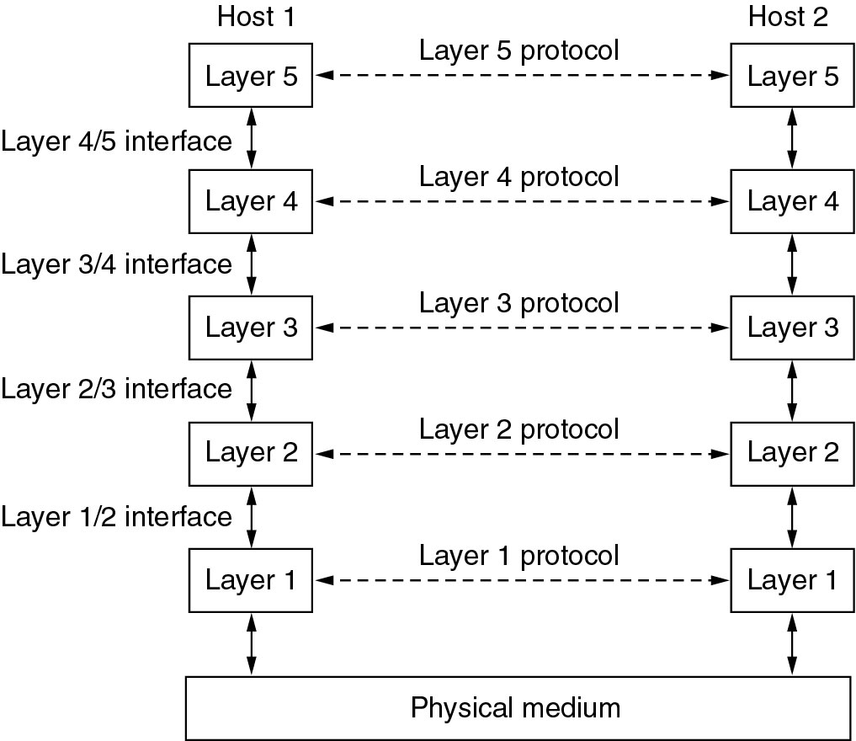
(4.2) The layering Principle (1)

Slide 9
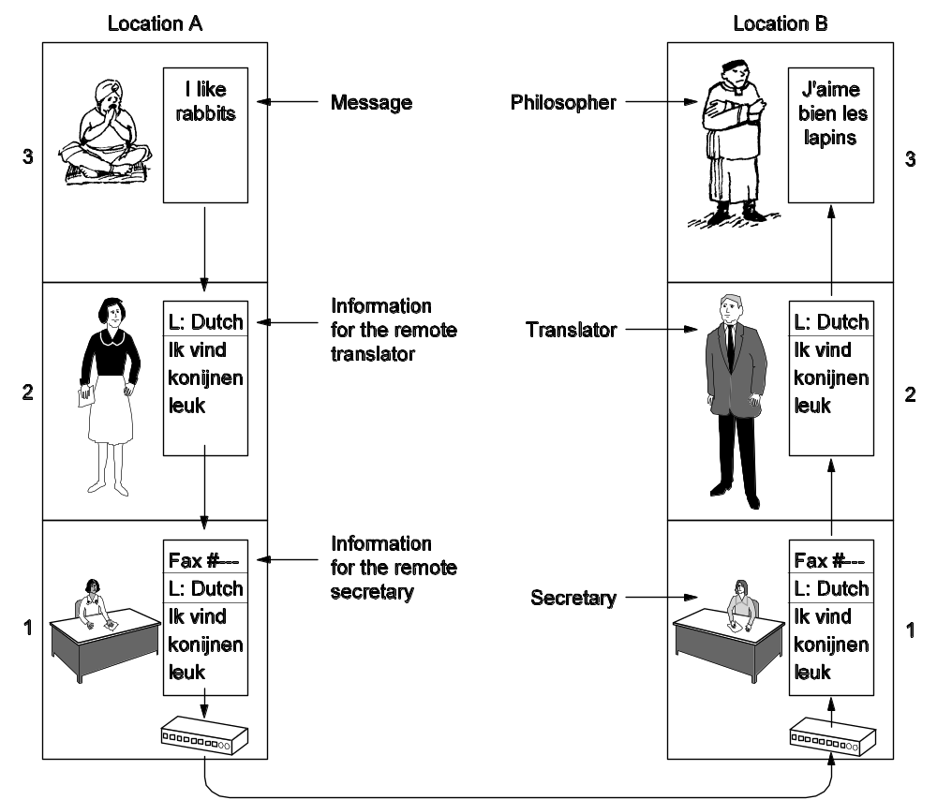
(4.2) The layering Principle (2)

Slide 10
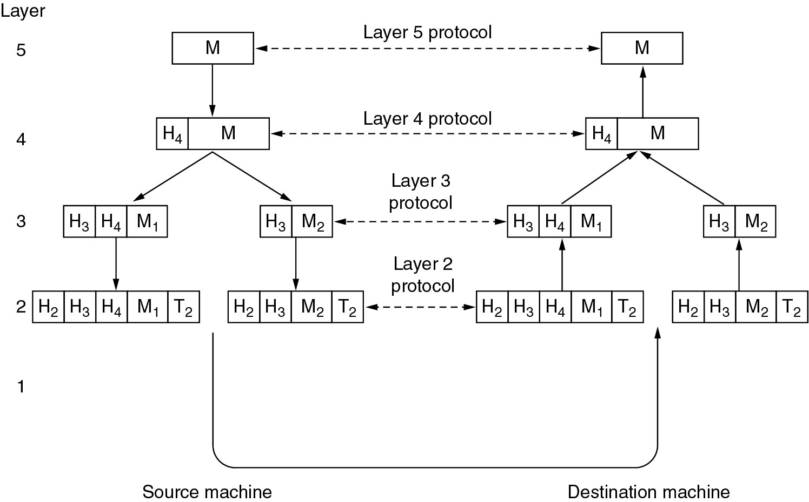
(4.2) The layering Principle (3)

Slide 11
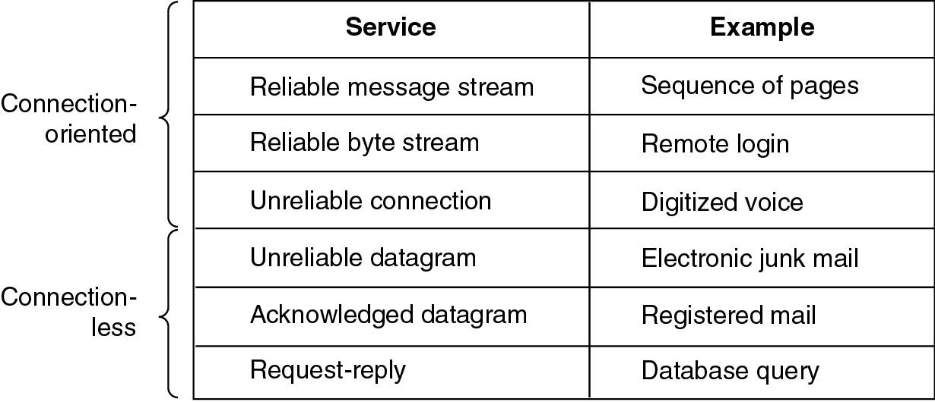
(5) Connection-Oriented vs. Connectionless

Slide 12
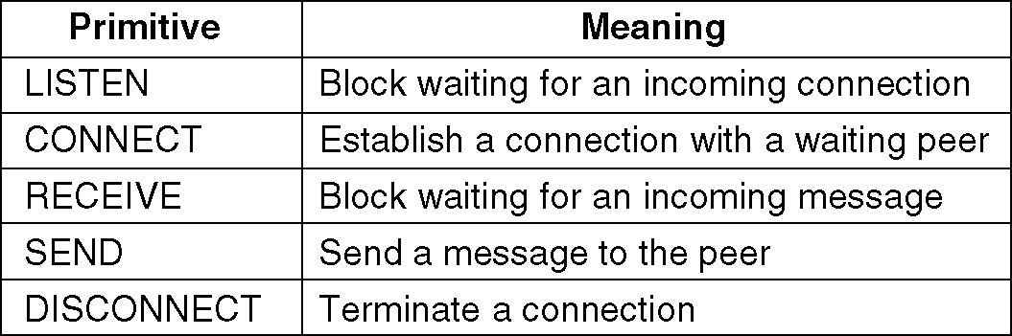
(6) Service Primitives
A service is formally specified by a set of primitives (basic operations) available to a user or other entity to access the service.
Example: five service primitives for implementing a simple connection-oriented service.
Notes:
Another example with html

Slide 13
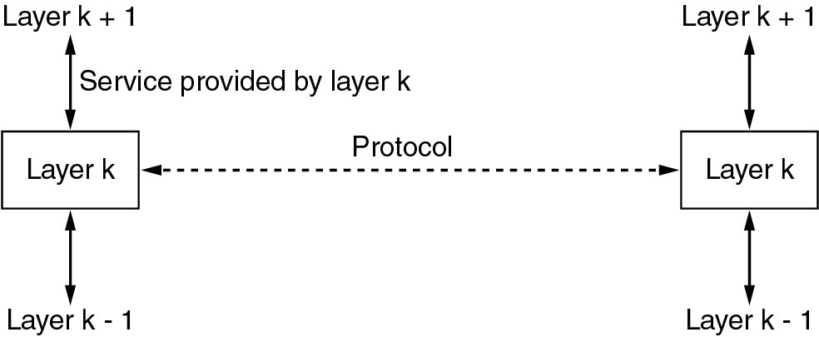
(7) The relationship of Service

Slide 14
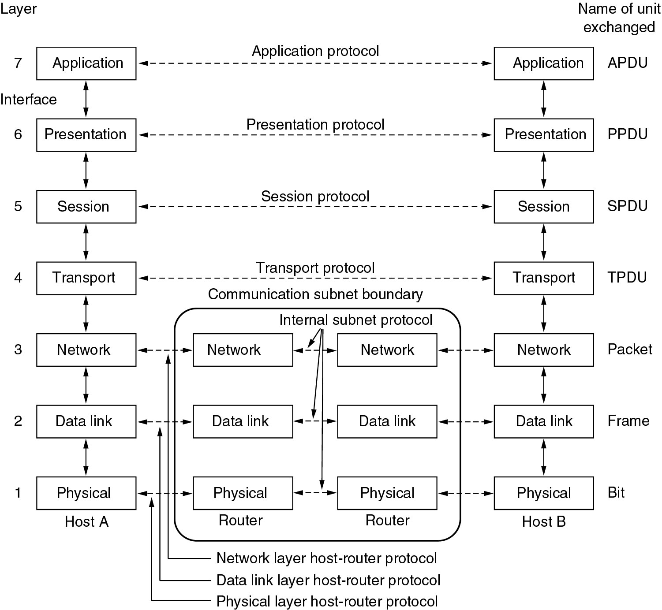
(8.1) The OSI Reference Model

Slide 15
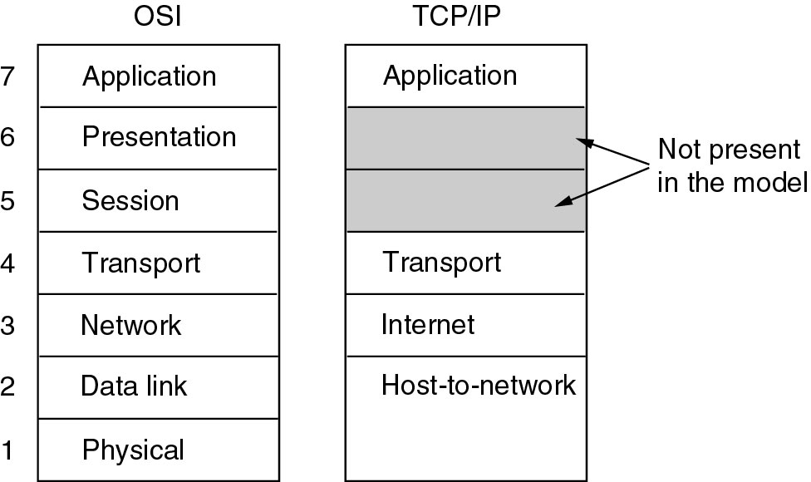
(8.2) The TCP/IP Reference Model (1)

Slide 16
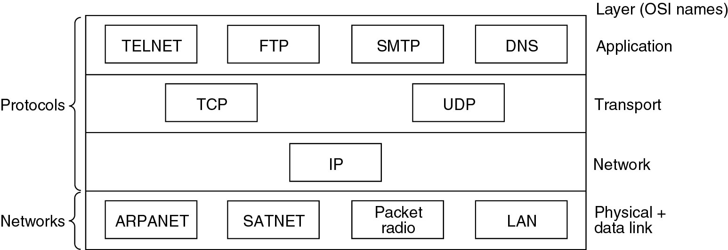
(8.2) The TCP/IP Reference Model (2)
Protocols and networks in the TCP/IP model initially.

Slide 17
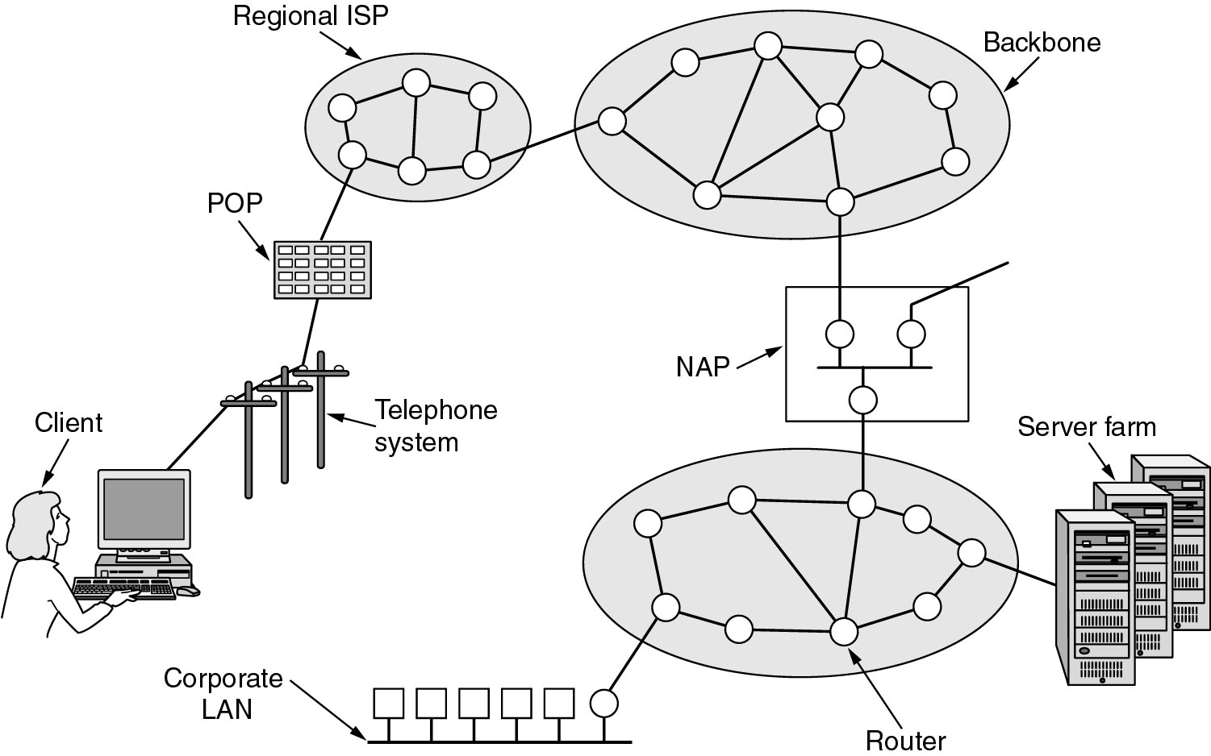
(8.2) The TCP/IP Reference Model (3)
Overview of the Internet.
Notes:
Add a logical view

